Slide 1

NUMBER PLATE DETECTION
-Aniket Malpure
-SrushtiChandak
-Ganesh Mehta

Slide 2
Problem Statement
Humans cannot practically keep an eye everywhere but they can use machines to do so. Our aim is to use concepts of Computer Vision and Machine Learning to trace stolen cars or vehicles which could further lead the trail of investigation from the data which has been made available to us.

Slide 3
Computer Vision
Using computer vision we can distinguish many different pieces of the images , identify the edges and model the subcomponents .Using filters and a series of actions ,we can piece all the parts of image together .The computer is not given the final image directly , it is often fed with thousands of related images to train it to identify a specific object and that is when Machine learning comes into picture.
.
Machine Learning
Machine Learning provides systems the ability to automatically learn and improve from experience without being explicitly programmed.The system is instead trained using the wide variety of data available . For example , when the system has a image input of vehicle with multiple rectangular surfaces such as buses or trucks , it has to be trained as to which rectangular input is to be taken and which all to be masked. Thus the machine has to learn what to take as input.This is possible using Machine Learning.

Slide 4

1. Let's consider a sample video which is broken into frames so that we can obtain image as input.
2. Resize the image to the required size and then grayscale it.
3. Use Bilateral filter. Using a bilateral filter(Blurring) will remove the unwanted details from an image.
4. The next step is performing edge detection using canny edge method.
5. Now we can start looking for contours on our image. Once the contours have been detected we sort them from big to small
6. Among the obtained results after contouring , we filter the license plate image by looping through all the results and check which has a rectangle shape contour with four sides and closed figure.
7. Proceed with masking the entire image except the number plate .
8. The next step in Number Plate Recognition is to segment the license plate out of the image by cropping it and saving it as a new image.
9. The final step is to actually read the number plate information from the segmented image using pytesseract package.
10. The characters thus obtained are mapped with the database so as to find licensed user of that number plate and result is displayed
SOLUTIONS

Slide 5
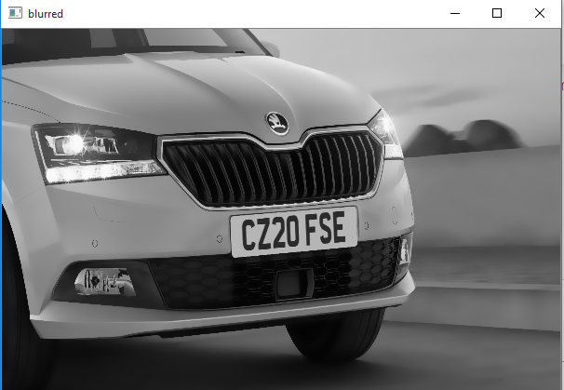
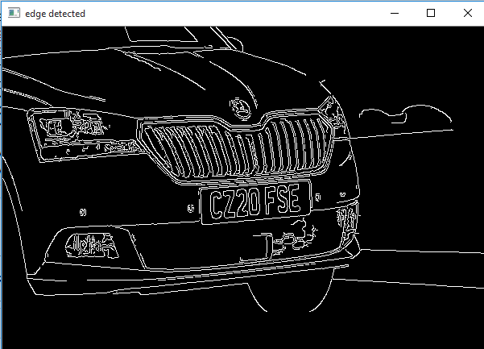
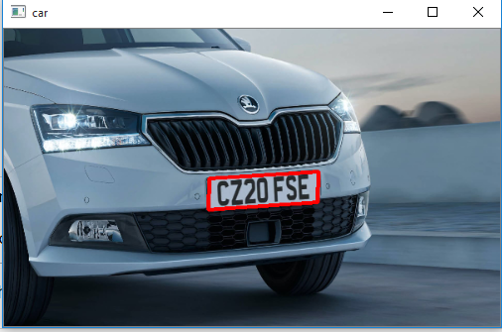
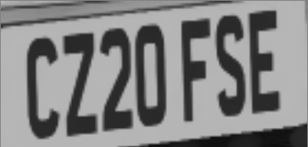
.
.
After Edge
Determination
Number plate detection
CZ20 FSE
Using
Pyteserract
Masking

Slide 6





TECH STACK
Pycharm
Pytesseract

Slide 7
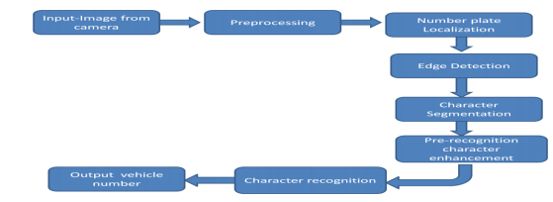
Case Diagram

Slide 8
UNIQUE SELLING POINTS
1) Most of the times , it is the number plate of the vehicle which gives a lead to further investigation.If the process of tracing the car could be made more efficient and quick , it would not only help the investigators but also put forward a technologically advanced front of the country to the world.
2) If this system is used by our country , it might help in reducing the ongoing theft to a great extent and build a stronger technological network.
FUTURE SCOPE
Once the system is adopted , its applications can be expanded.
For example , In some cities on breaking the traffic rules , the person breaking the rules is contacted manually . The person who broke the rule could be contacted without any human help if this system is given the access by using Ipsec framework, the data can be securely transfered which will help in further investigation.

